Slide 1


<Łukasz Bik>
<11.06.2024>

Slide 2
Outline
Executive Summary
Introduction
Methodology
Results
Conclusion
Appendix

Slide 3
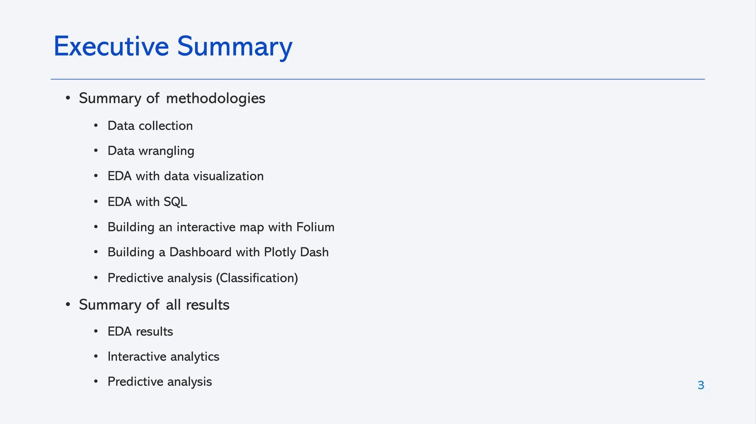
Executive Summary
Summary of methodologies
Summary of all results

Slide 4
Introduction
Project background and context
SpaceX offers Falcon 9 rocket launches on its website for a price of 62 million dollars, while other companies charge over 165 million dollars per launch. A significant portion of these savings is due to SpaceX's ability to reuse the rocket's first stage. Therefore, if we can predict whether the first stage will land successfully, we can estimate the cost of a launch. This information can be useful for other companies looking to compete with SpaceX in rocket launch bids. The aim of this project is to create a machine learning pipeline that can predict the successful landing of the first stage of the rocket.
Problems you want to find answers
What factors influence the successful landing of the rocket?
What interactions between different features affect the success rate of the landing?
What operational conditions need to be met to ensure a successful landing?

Slide 5

Section 1
5

Slide 6
Methodology
Executive Summary
Data collection methodology:
Data was gathered using the SpaceX API and through web scraping from Wikipedia.
Perform data wrangling
One-hot encoding was used for the categorical features.
Perform exploratory data analysis (EDA) using visualization and SQL
Perform interactive visual analytics using Folium and Plotly Dash
Perform predictive analysis using classification models
Logistic Regression, k-nearest neighbors, Support Vector Machines, and decision tree models were developed to identify the most effective classification method.

Slide 7
Data Collection
Data was gathered through multiple approaches:
Initial data acquisition involved making a GET request to the SpaceX API.
Subsequently, we parsed the JSON response using the .json() function and transformed it into a pandas dataframe using .json_normalize().
Following this, data cleaning was conducted, including checking for and filling in missing values as needed.
Additionally, Falcon 9 launch records were extracted from Wikipedia using BeautifulSoup through web scraping.
The goal was to retrieve launch data formatted as an HTML table, parse the table, and convert it into a pandas dataframe for future analysis.

Slide 8
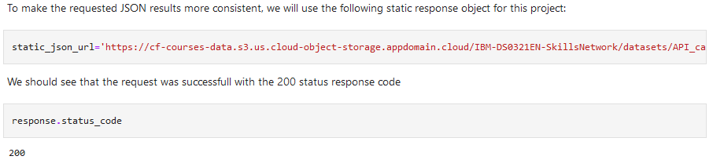
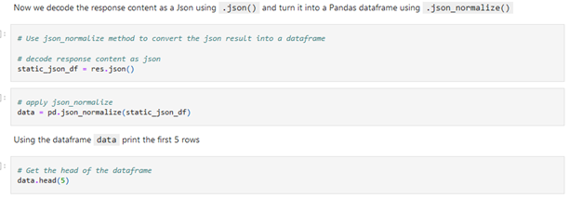
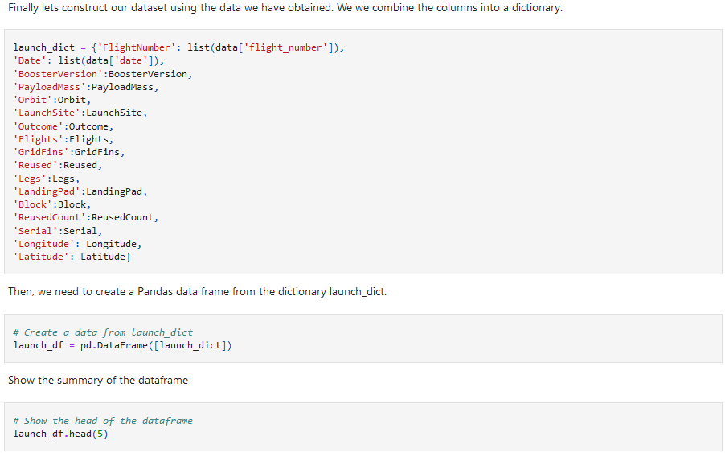
Data Collection – SpaceX API
1.Requested and parsed the data from the SpaceX API using a GET request.
2.Stored the data and constructed the dataset into a new dictionary with relevant columns.
3.Filtered the dataframe to include only Falcon 9 launches required for project analysis.
4.Cleaned the data and removed missing values of PayloadMass.
GitHub link reference:
Data Collection.ipynb

Slide 9
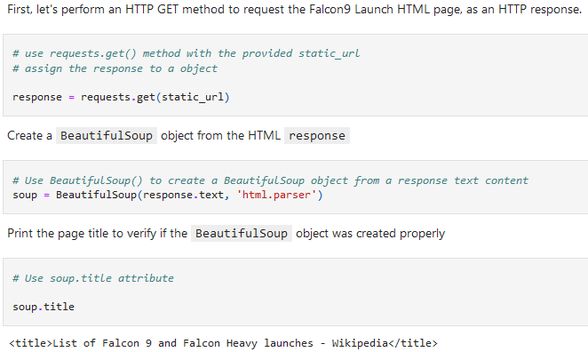
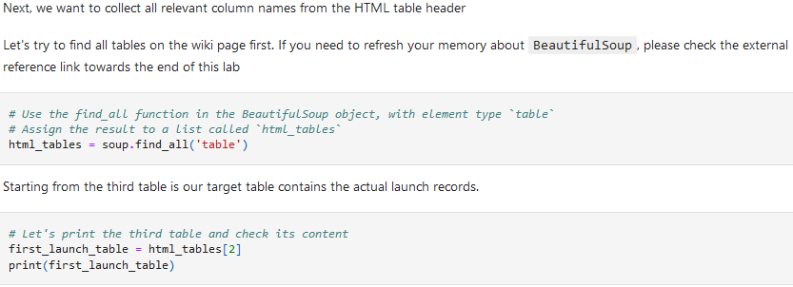
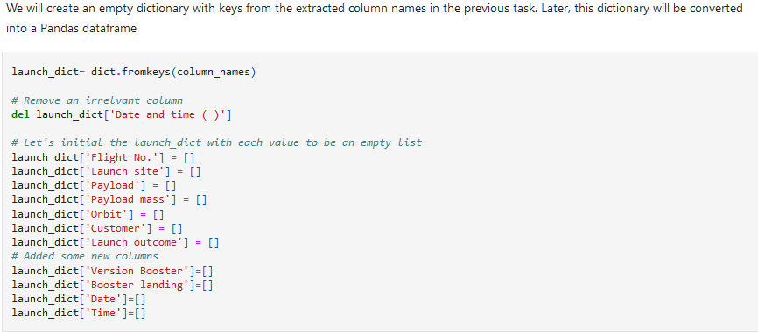
Data Collection - Scraping
Requested data from Wikipedia using an HTTP GET request and BeautifulSoup.
Extracted all column names from the HTML table header.
Cleaned the column data, created an empty dictionary with the extracted columns, and appended the column names. Created a dataframe by parsing the launch HTML tables.
GitHub link reference:
Data collection using Web Scraping.ipynb

Slide 10
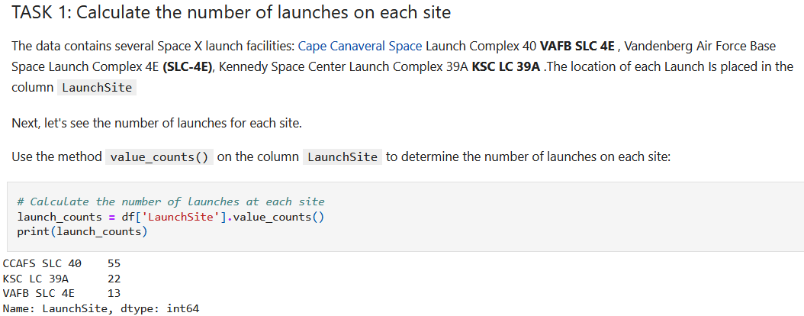
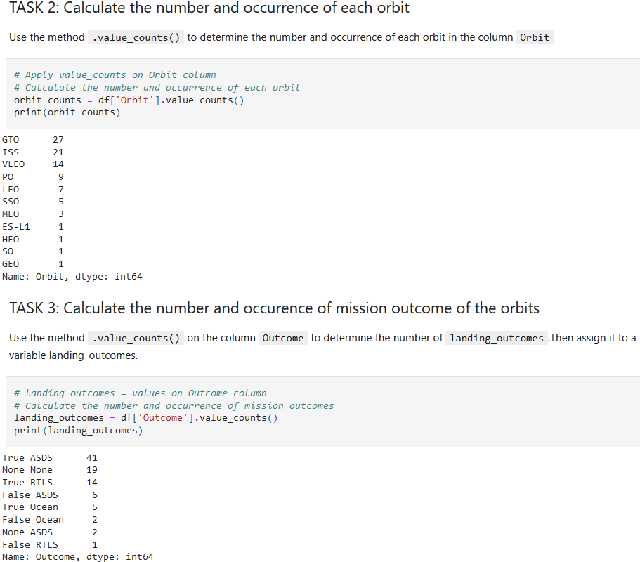
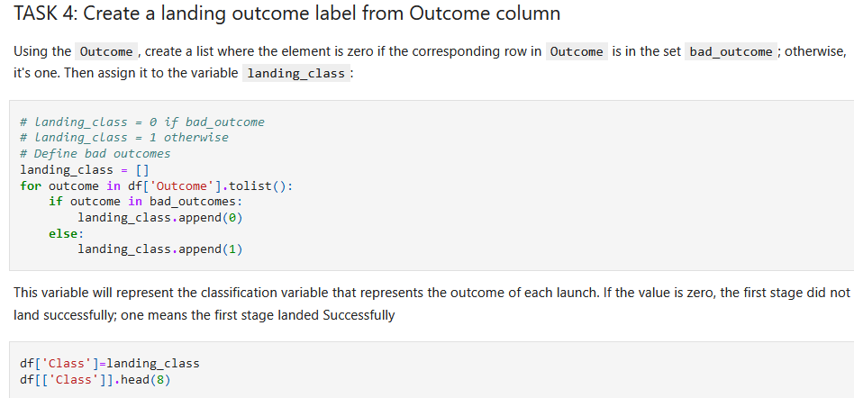
Data Wrangling
Determined the number of launches from each site.
Determined the count and occurrence of each orbit and its mission outcome.
Created a landing outcome label based on the outcome column.
Computed the average success rate.
GitHub link reference: Data wrangling.ipynb

Slide 11
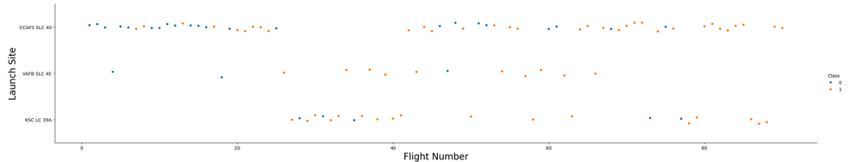
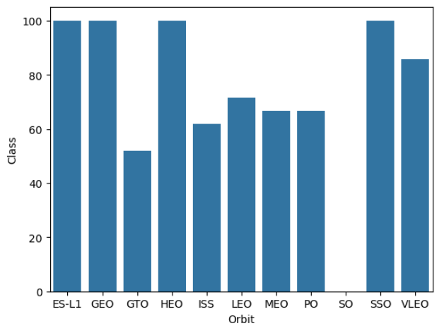
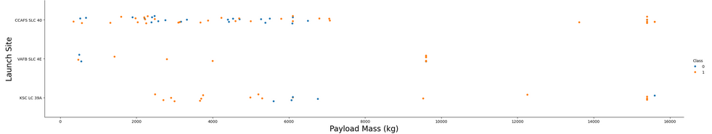
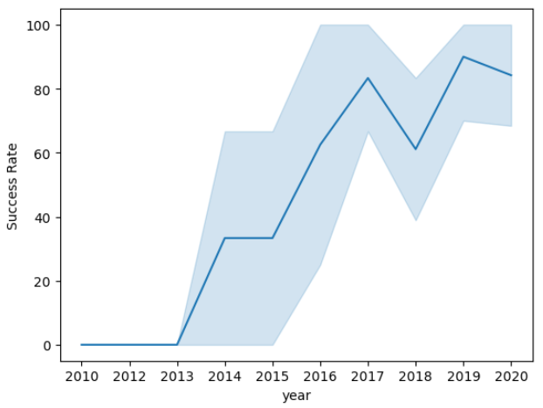
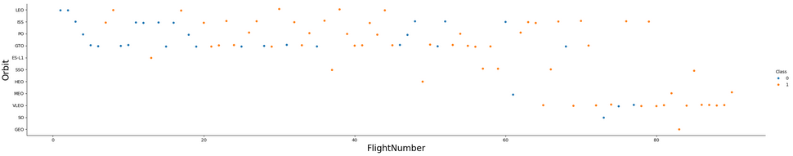
EDA with Data Visualization
GitHub link reference:
Eda data with Visualization.ipynb
Scatter point charts are used to visualize the relationship between
(1) Flight number and lunch site, (2) Payload and lunch site, (3) Flight number and orbit type.
Bar chart was used to visualize the relationship between success rates of each orbit type.
Line chart was used to visualize the yearly trend of launch success.

Slide 12
EDA with SQL
SQL queries are performed to:
Retrieve the names of unique launch sites.
Display 5 records where launch sites begin with the string 'CCA’.
Show the total payload mass carried by boosters launched by NASA (CRS).
Display the average payload mass carried by booster version F9 v1.1.
List the date when the first successful landing on a ground pad was achieved.
List the names of boosters that have successful landings on drone ships and have a payload mass greater than 4000 but less than 6000.
List the total number of successful and failed mission outcomes.
List the names of the booster versions that have carried the maximum payload mass using a subquery.
Display the failed landing outcomes on drone ships, along with their booster version and launch site names.
GitHub link reference:
Eda - SQL.ipynb

Slide 13
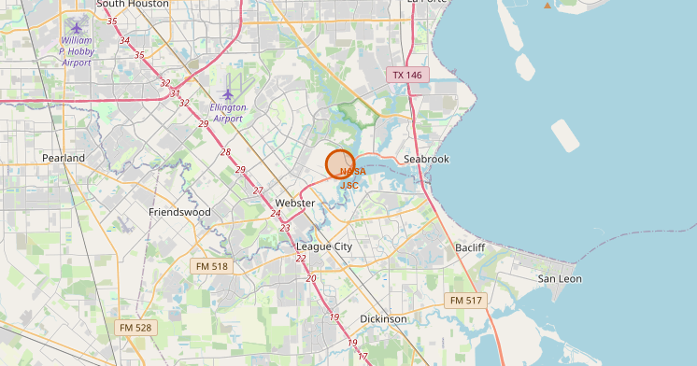
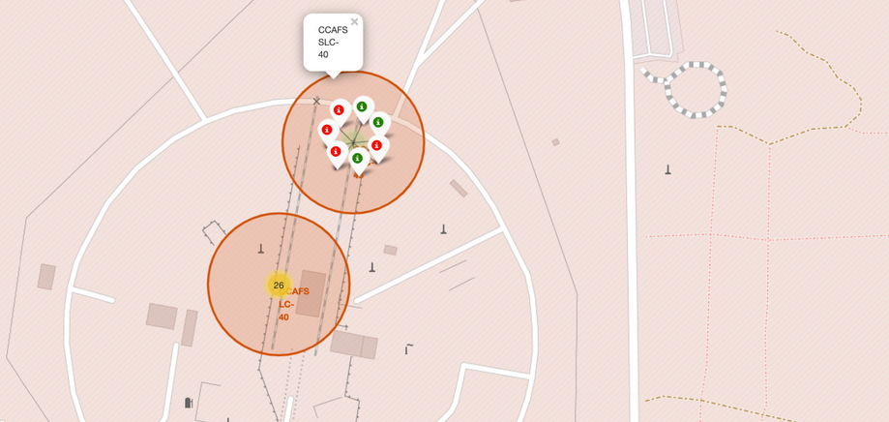
Build an Interactive Map with Folium
We marked all launch sites and added map objects such as markers, circles, and lines to indicate the success or failure of launches for each site on the folium map.
We assigned launch outcomes (failure or success) to classes 0 and 1, i.e., 0 for failure and 1 for success.
Using color-labeled marker clusters, we identified which launch sites have a relatively high success rate.
We calculated the distances between each launch site and its surroundings. We answered some questions, for instance:
Are launch sites near railways, highways, and coastlines?
Do launch sites maintain a certain distance from cities?
GitHub link reference:
Folium - Visual Analytics.ipynb

Slide 14
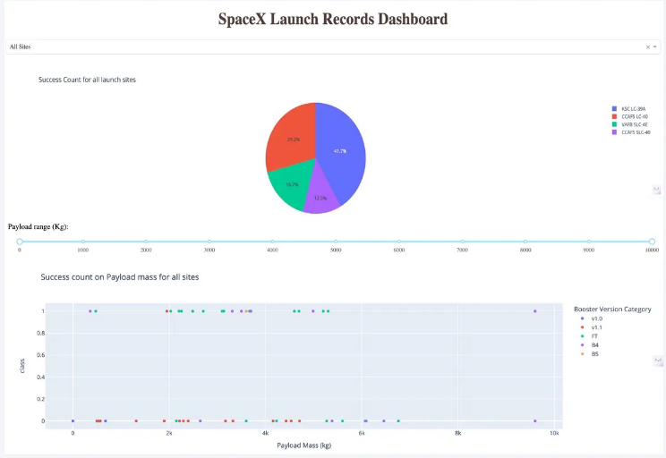
Build a Dashboard with Plotly Dash
An interactive dashboard was constructed using Plotly Dash.
Pie charts were generated displaying the total launches from specific sites.
Scatter plots were created to illustrate the relationship between Outcome and Payload Mass (Kg) for various booster versions.
GitHub link reference:
Build a Dashboard with Plotly Dash.py

Slide 15
Predictive Analysis (Classification)
Various machine learning models were constructed and hyperparameters were optimized using GridSearchCV.
2. Accuracy served as the primary metric for model evaluation, with enhancements made through feature engineering and algorithm tuning.
3. The most effective classification model was identified through experimentation.
4. Data was imported using numpy and pandas, processed, and divided into training and testing sets.
GitHub link reference:
Machine Learning Prediction.ipynb

Slide 16
Results
Logistic Regression (LR), Support Vector Machines (SVM), and K-Nearest Neighbors (KNN) are the most effective models for predicting outcomes in this dataset.
Payloads with lower weight demonstrate better performance compared to heavier ones.
The probability of a SpaceX launch succeeding increases with the accumulated years of experience, indicating a trend towards increasingly successful launches over time.
Launch Complex 39A at Kennedy Space Center boasts the highest number of successful launches among all launch sites.

Slide 17

Section 2

Slide 18
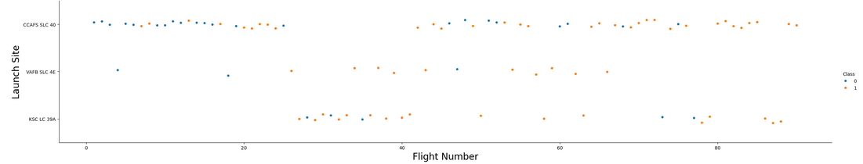
Flight Number vs. Launch Site
The total number of launches from Launch Complex 40 at Cape Canaveral Space Launch Complex (CCAFS SLC-40) is notably higher than from other launch sites.

Slide 19
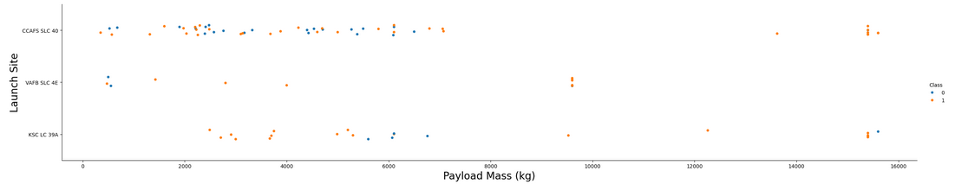
Payload vs. Launch Site
Payloads with lower mass have more launches compared to those with higher mass across all three launch sites.

Slide 20

Success Rate vs. Orbit Type
The orbit types ES-L1, GEO, HEO, and SSO exhibit the highest success rates among all.

Slide 21
Flight Number vs. Orbit Type
In the earlier years, LEO, ISS, PO, and GTO orbits had the most launches, but over time, the focus gradually shifted to VLEO orbit.

Slide 22
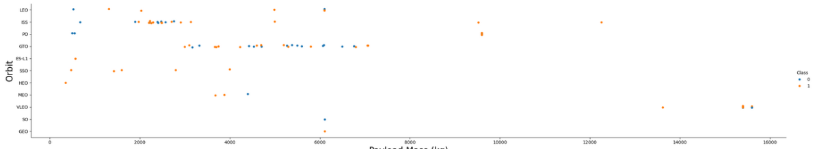
Payload vs. Orbit Type
Heavy payloads tend to have higher successful landing rates for PO, LEO, and ISS orbits, but for GTO orbit, success is less predictable with nearly an equal distribution of successes and failures.

Slide 23
Launch Success Yearly Trend
The success rate of launches has been increasing from 2013 to 2020, likely due to advancements in technology and accumulated experience.

Slide 24
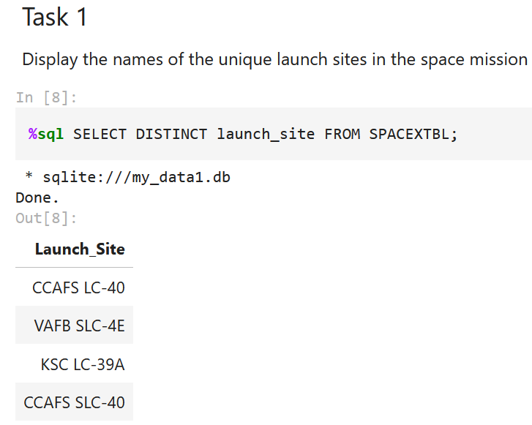
All Launch Site Names
Executed an SQL query to retrieve all launch site names.

Slide 25
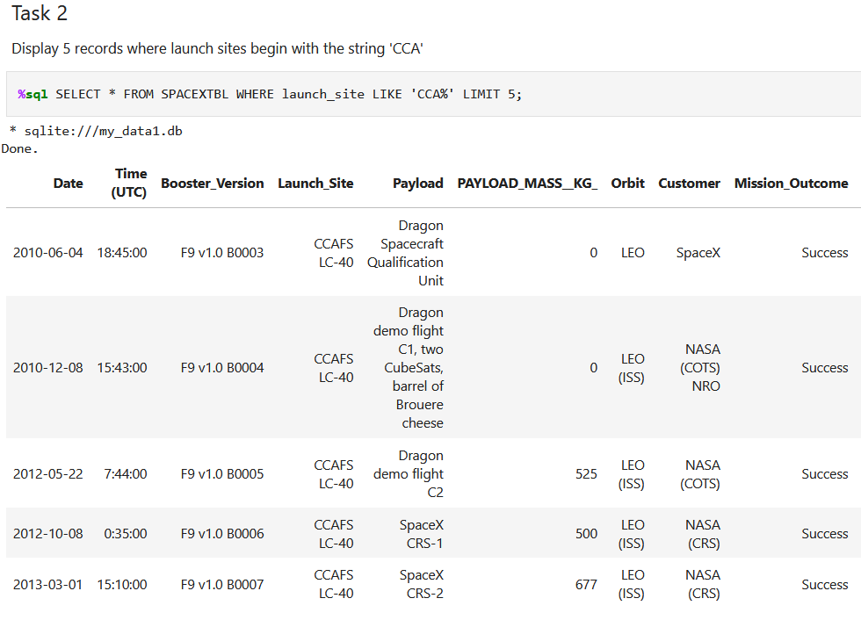
Launch Site Names Begin with 'CCA'
Executed an SQL query to retrieve 5 launch site names that start with 'CCA'.

Slide 26
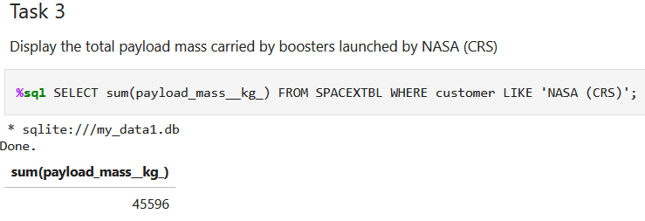
Total Payload Mass
Executed an SQL query to retrieve the total payload mass carried by boosters launched by NASA (CRS).

Slide 27
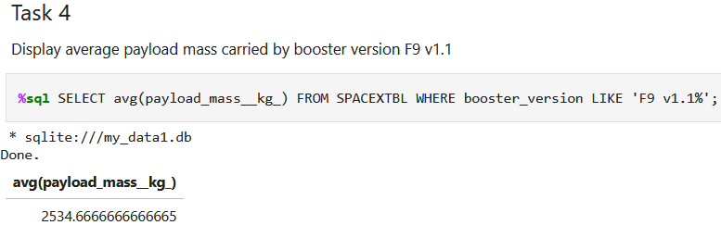
Average Payload Mass by F9 v1.1
Executed an SQL query to calculate the average payload mass carried by booster version F9 v1.1.

Slide 28
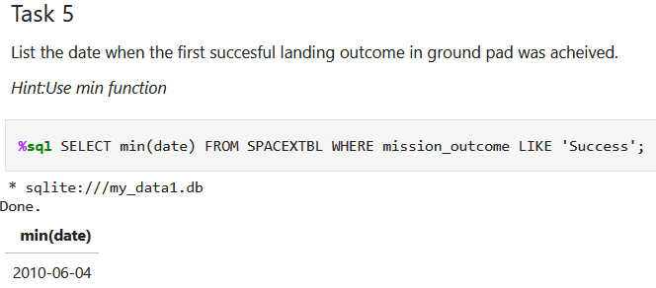
First Successful Ground Landing Date
Executed an SQL query to find the dates of the first successful landing on a ground pad.

Slide 29
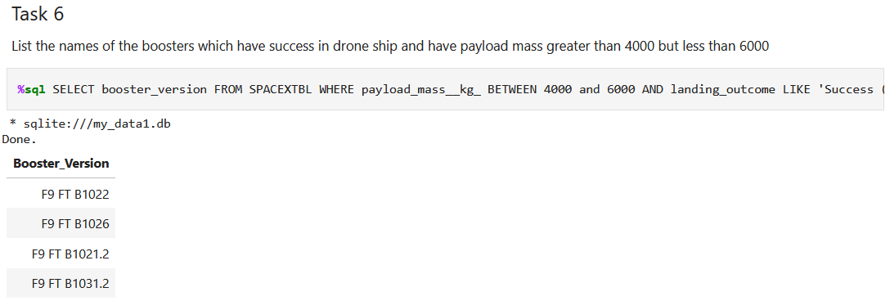
Successful Drone Ship Landing with Payload between 4000 and 6000
Executed an SQL query to list the names of boosters that successfully landed on a drone ship with a payload mass between 4000 and 6000.
entire code:
%sql SELECT booster_version FROM SPACEXTBL WHERE payload_mass__kg_ BETWEEN 4000 and 6000 AND landing_outcome LIKE 'Success (drone ship)';

Slide 30
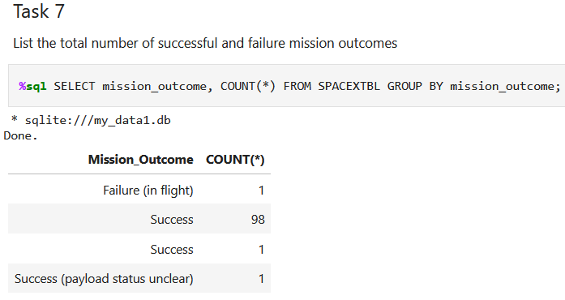
Total Number of Successful and Failure Mission Outcomes
Executed an SQL query to calculate the total
number of successful and failed mission outcomes.

Slide 31
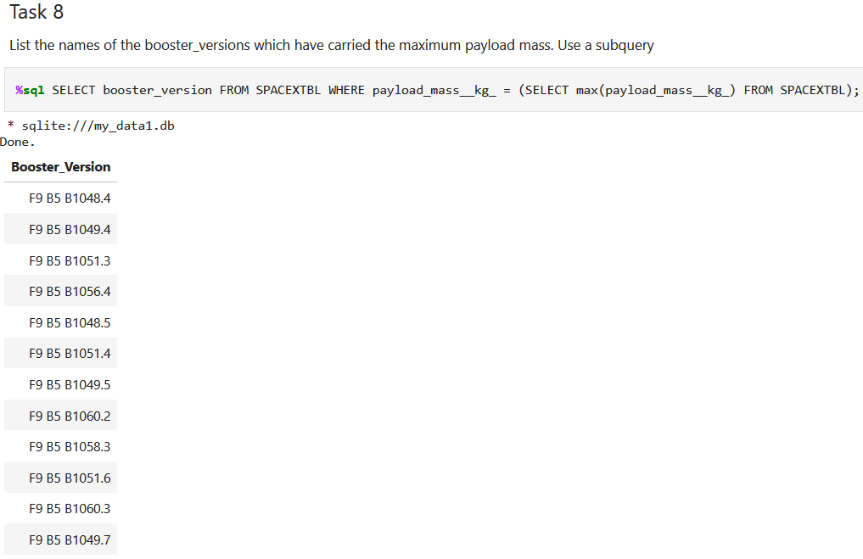
Boosters Carried Maximum Payload
Executed an SQL query to list the names of the booster that have carried the maximum payload mass.

Slide 32
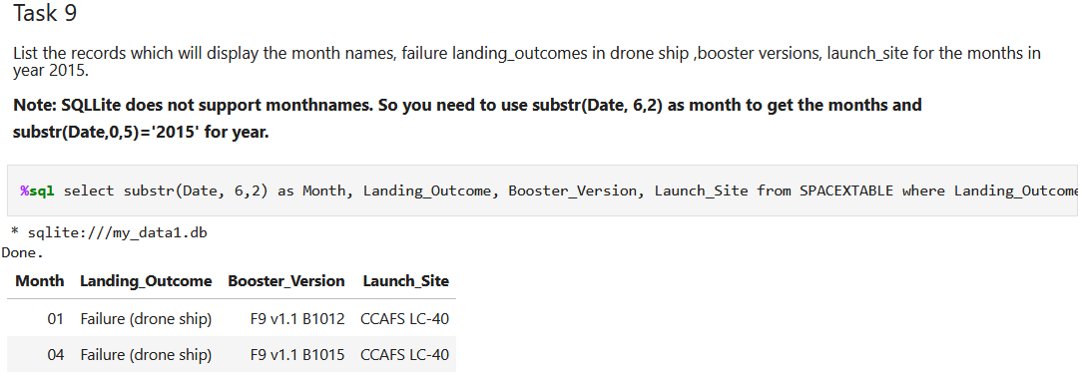
2015 Launch Records
Executed an SQL query to list the failed landing outcomes on drone ships, along with their booster versions and launch site names for the year 2015.

Slide 33
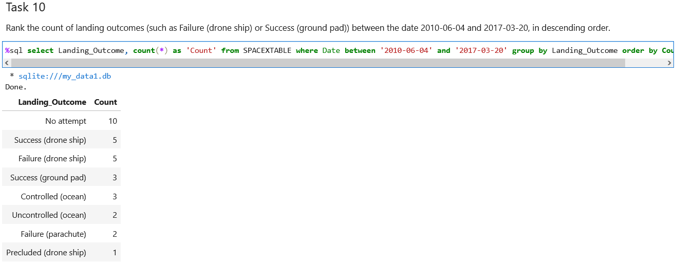
Rank Landing Outcomes Between 2010-06-04 and 2017-03-20
Executed an SQL query to rank the count of
landing outcomes (such as Failure (drone ship) or Success (ground pad)) between the dates 2010-06-04 and 2017-03-20 in descending order.

Slide 34

Section 3

Slide 35
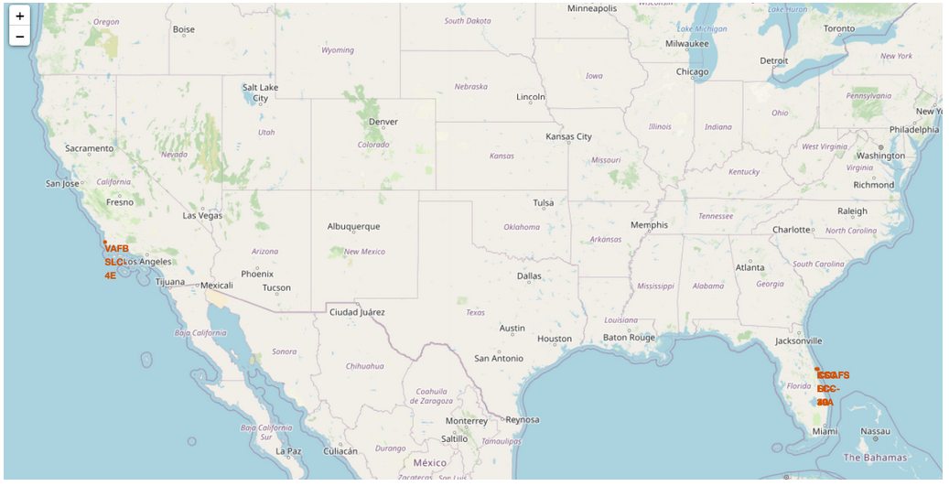
All launch sites on a map
The launch sites are marked with a marker indicating their names on the map.

Slide 36
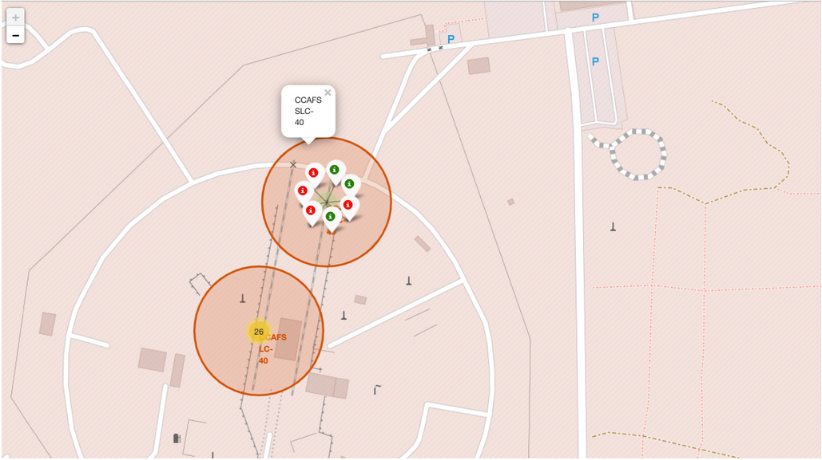
All success/failed launches for each site on the map
The launch records are clustered on the map and labeled with green markers for successful launches and red markers for unsuccessful ones.

Slide 37
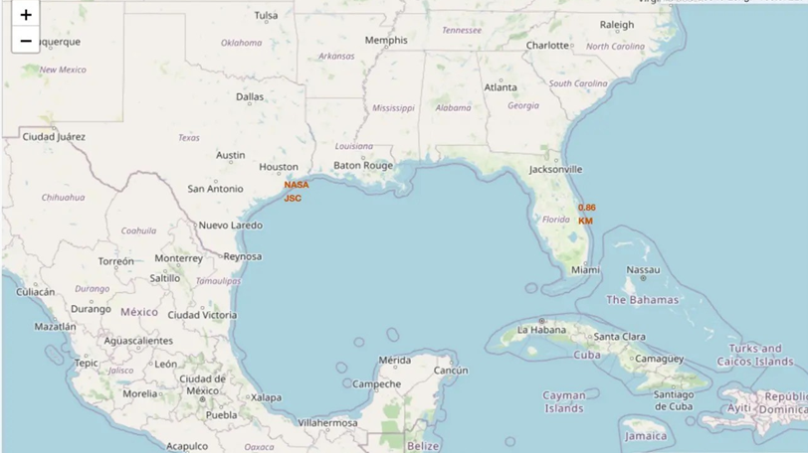
Distances between a launch site to its proximities
The nearest coastline from NASA JSC is marked as a point using MousePosition, and the distance between the coastline point and the launch site is approximately 0.86 km

Slide 38

Section 4

Slide 39
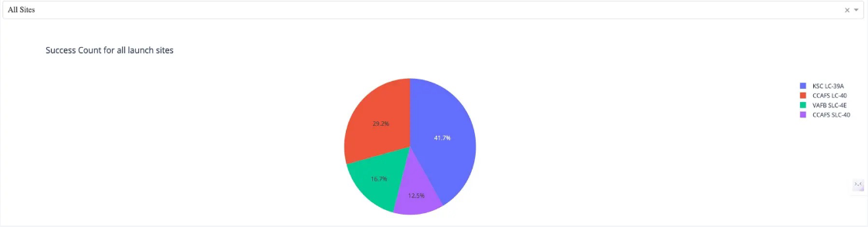
Total success launches for all sites
KSC LC-39A has the highest percentage of successfullaunches at 41.7% from the entire record, while CCAFS SLC-40 has the lowest percentage of successful launches at only 12.5%.

Slide 40
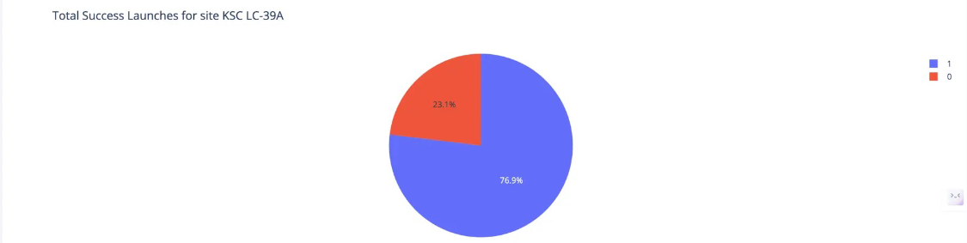
Success ratio of the launch site with the highest success launches
KSC LC-39A, the launch site with the highest number of successful launches, boasts a 76.9% success rate and a 23.1% failure rate for launches from its site.

Slide 41
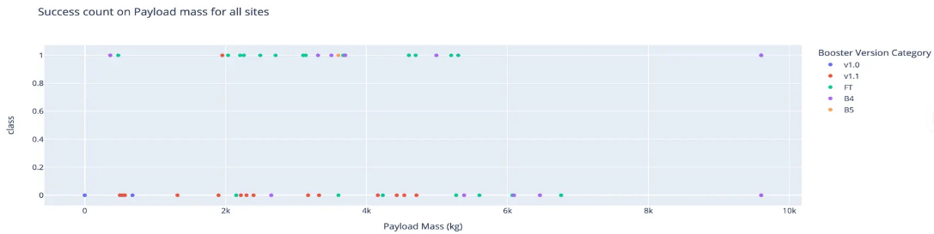
Payload vs launch outcome
1.The payload range with the highest number of successful launches is between 2000 to 4000 kg, as evidenced by the largest number of occurrences in that range, followed by the payload range of 4000 to 6000 kg, which has the second highest number of occurrences.
2.Booster version FT (green markers) has the highest number of successful launches, followed by B4 (purple markers) with the second highest number of successful launches among all booster versions.

Slide 42

Section 5

Slide 43
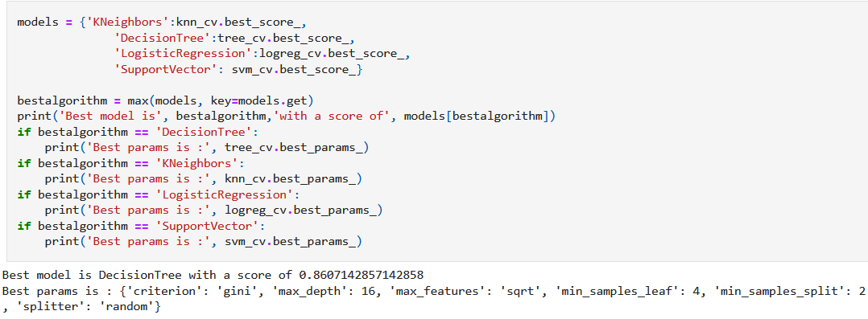
Classification Accuracy
The most effective method is Decision Tree with a score of 0.8607. This method operates by recursively splitting the dataset based on features, enabling efficient prediction of target values for new data points.

Slide 44
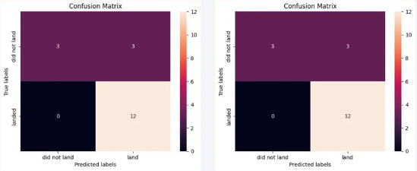
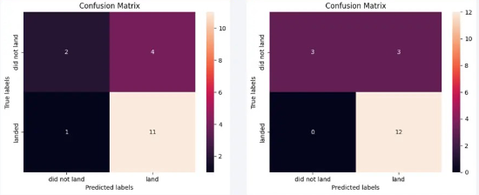
Confusion Matrix
Confusion Matrix of LR
Confusion Matrix of SVM
1. LR, SVM, KNN models perform well, as their confusion matrices show they correctly predicted all 12 successful landings without any errors.
2. However, the Decision Tree model correctly predicted 11 successful landings but incorrectly predicted one as a failure.
Confusion Matrix of
decision tree
Confusion Matrix of KNN
3. LR, SVM, and KNN models have the same accuracy of 83.33% as shown earlier, hence they share the same confusion matrix.

Slide 45
Conclusions
1. Logistic Regression (LR), Support Vector Machines (SVM), and K-Nearest Neighbors (KNN) are the leading models for predicting outcomes in this dataset.
2. Payloads with lower weight demonstrate better performance compared to heavier ones.
3. The probability of a SpaceX launch succeeding increases with accumulated years of experience, indicating a trend towards flawless launches over time.
4. Launch Complex 39A at Kennedy Space Center records the highest number of successful launches compared to other launch sites.
5. Orbit types GEO, HEO, SSO, and ES L1 exhibit the highest rates of successful launches.

Slide 46


